Slide 1
Research Ethics 3
23-4-21
What happens to those who
violate responsible conduct?

Slide 2
6. Mechanisms to prevent conflict of interest
A long set of guidelines
A legal contract between the author and the publisher.
An undertaking from the authors.
A warning of stringent consequences in case of violation of ethics.
These are some of the existing mechanisms that serve the purpose.
LEGAL PRECAUTIONS

Slide 3
To sum up
Several kinds of misconduct can be prevented.
Some of the methods involve the following:
A peer review system
Technology
Special software
Certain actions between the submission and publication.
Legal precautions
These are pre-publication-steps.

Slide 4
Some others are post-publication-steps:
Critical reviews of published articles.
Black-listing.
Punishment at the institution. (It may even cost one’s job).

Slide 5
1’. More about peer review process
The referees sometimes suggest the following kinds of revision of the paper:
Specific references have to be cited. (They may even give a list).
They provide the details of a previously published paper and suggest that the authors have to revise their paper after going through that.
If there are internal inconsistencies that call for corrections or further explanations, often they clearly describe these inconsistencies. (It may be that the data collected do not tally with the conclusion; or it may be that an argument is invalid).
They point out “mis-representation of others’ works” and “failure to acknowledge some known work”.

Slide 6
2’ More on the use of technology
The advancing technology can be used for the good and the bad.
Just as it can be used to prevent unethical practices in research, it can also be used in generating further unethical practices in research.
In today’s class, we confine to the positive uses of technology.
Here is an instance.
If a researcher has deliberately tampered with the data to draw wrong conclusions, a machine can point out the discrepancy and its location.

Slide 7
3’. More on Software
Agenda :
• Why Turnitin similarity check report. • Instructor Management/ Student Management • Creation of Class and Assignment. • Interpreting of Similarity Reports in Turnitin. • Reviewing student Submission with a similarity report. • Feedback to students. • Similarity Report download.
Webinar on Turnitin

Slide 8
4’ More on Pre-publication-care
The editors provide a checklist to be filled by the authors.
The editors take the consent of all the co-authors.
The pre-reviewers ensure that the arguments are valid.
The specialized proof-readers see that there are no unnecessary repetitions or syntactic mistakes.

Slide 9
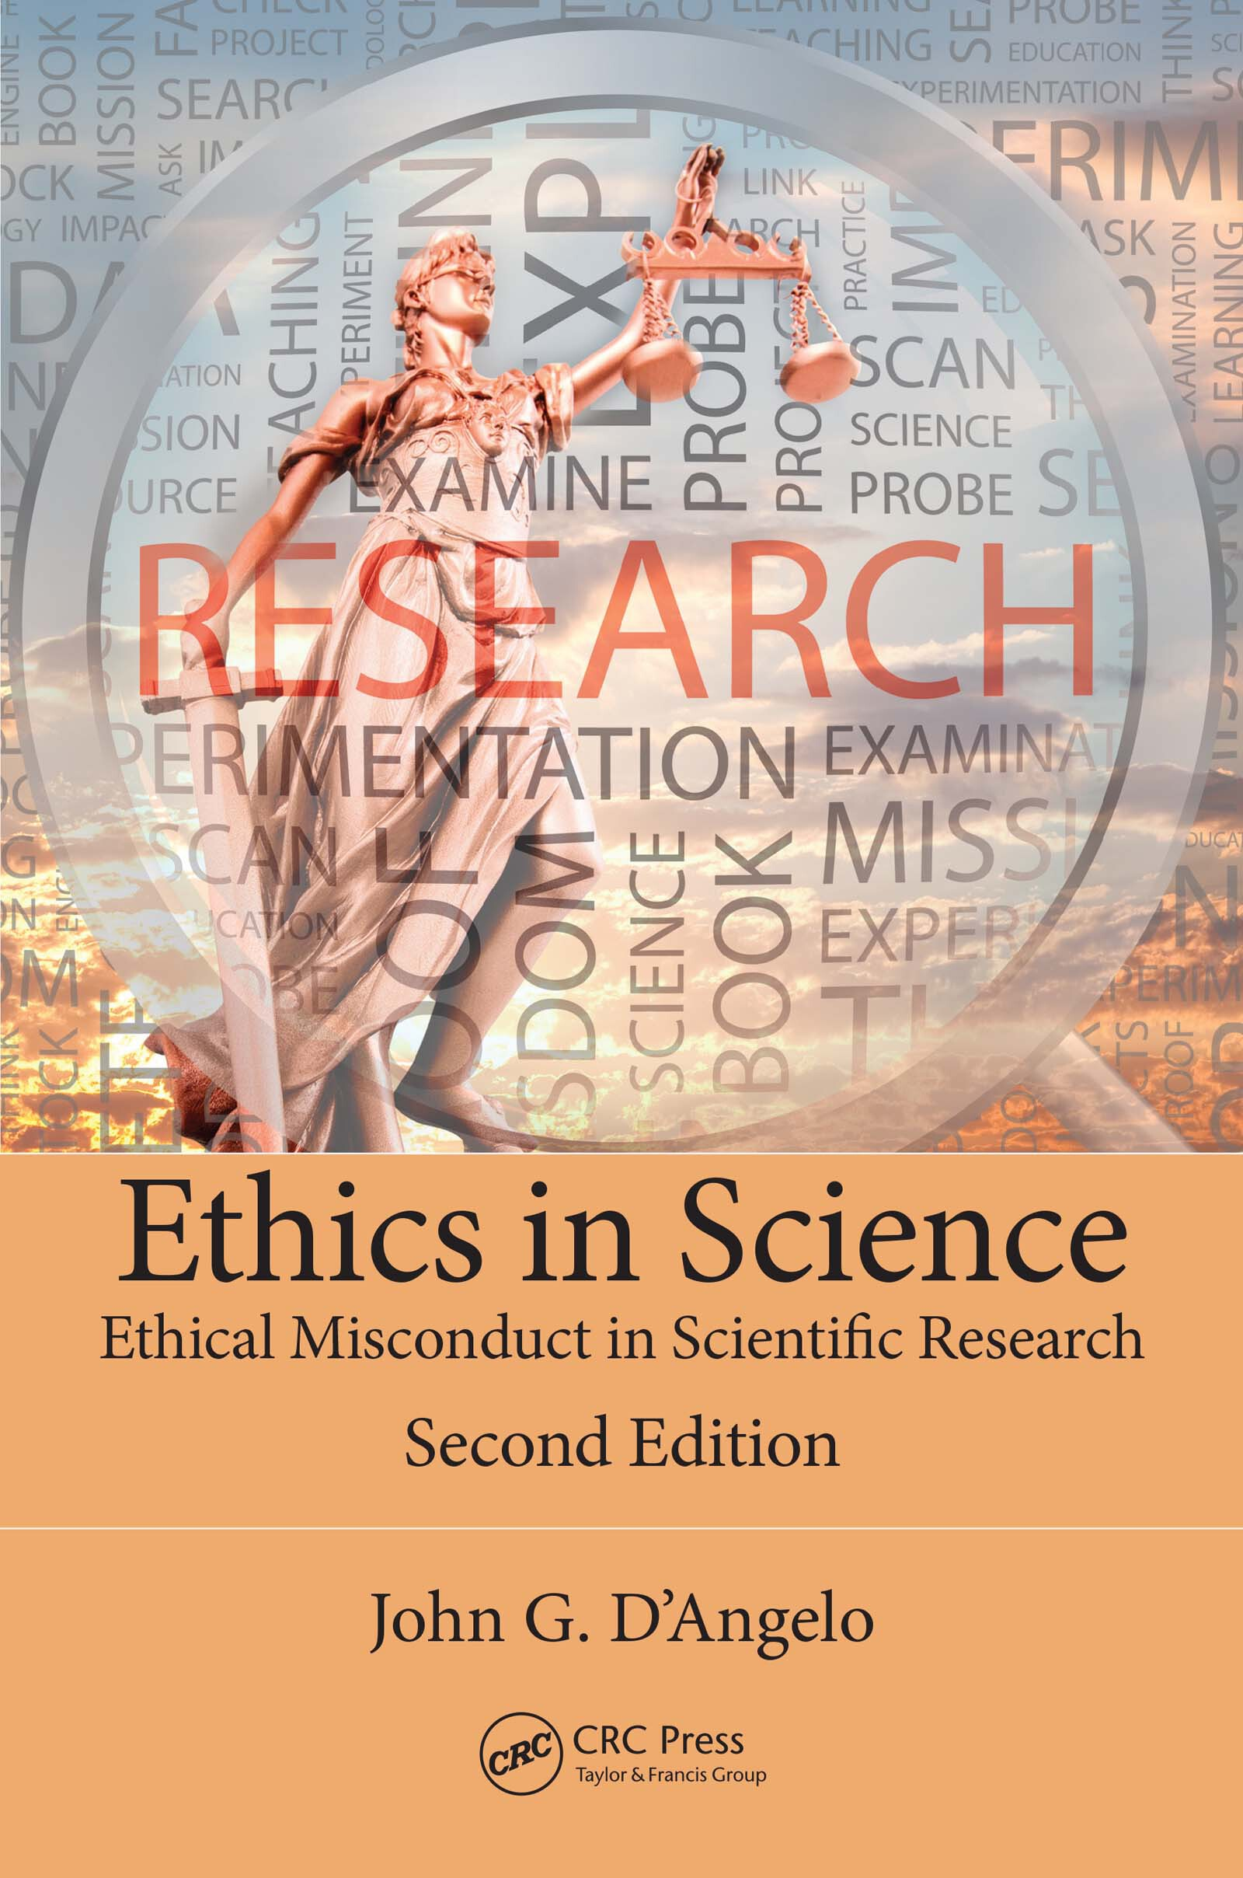

Books followed

Slide 10
10 types of research misconduct
Misappropriation of ideas
Plagiarism
Self-plagiarism
Claiming undeserved authorship
Misuse of research funds
Deceptive generation of preferred results
Falsification of data
Denial of credits to others.
Repeated publication of too similar results.
Mis-representation of others’ results.

Slide 11
When fabrication of data is discovered, the penalty is very severe.
The offending researcher may be fired, denied a degree
or even have funding revoked. Further, the paper or papers
containing the fabricated data would certainly be retracted

Slide 12
significant embarrassment
befalls the journal, the researchers, and the associated university or
company.

Slide 13
Any negative attention (and this certainly constitutes negative
attention) could potentially bring funding and public support to a halt.

Slide 14
not only the
researcher but also the field can potentially suffer severe repercussions
when fraud occurs.

Slide 15
Diversion of scientists down unproductive lines of research
• Unfair distribution of scientific resources
• Inappropriate medical treatment for patients
• Erosion of public confidence in science
• Erosion of public financial support for science

Slide 16
posed a one- to three-year ban on
publishing in the journal on the authors. The editors go on in their letter to
mention that other penalties that they would consider levying on perpetrators
of scientific misconduct to include notifying their reviewers and the
editors of previous journals a manuscript was found to be submitted to

